Slide 1
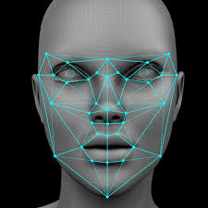
Real-time face recognition & detection.
Industrial Training (ECS791)
Project Guide: Ms. Rohaila Naaz
Presented by:
TCA1809072 Kshma Sethi

Slide 2

A face detection & recognition system deals with automatically identifying or verifying a person from a digital image or video source by comparing selected facial features. It is a form of identity access management and access control. Therefore, face recognition seems to be the most universal, non-intrusive, and accessible system.

Slide 3
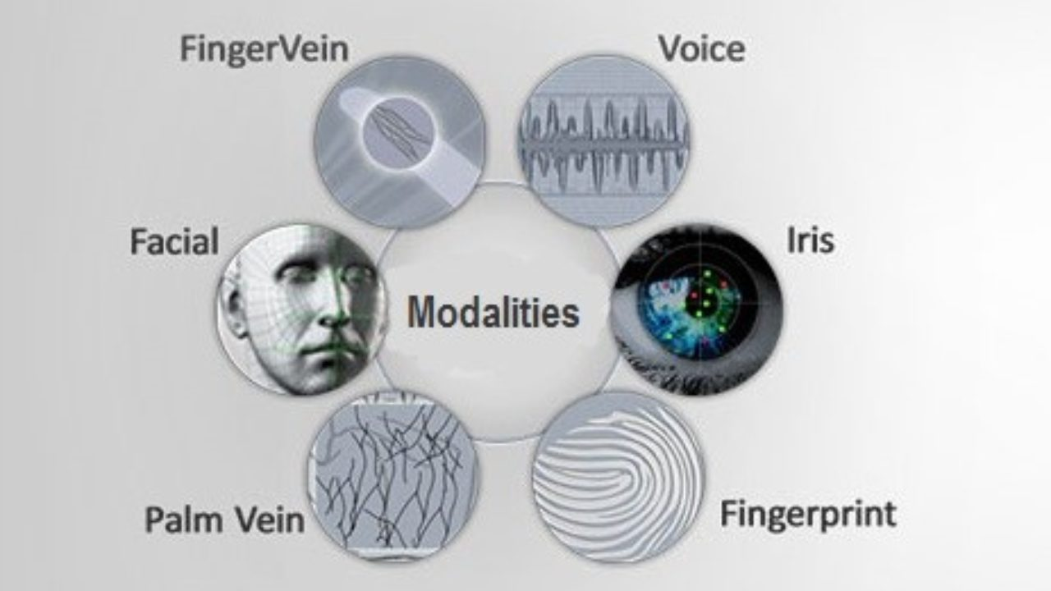
A face recognition system is one of the biometric information processes, its applicability is easier and working range is larger than others.
It allows us to perform passive identification as it requires no physical interaction on behalf of the user.
It can use existing hardware infrastructure, existing cameras and image capturing devices .

Slide 4
Face detection means that a system is able to identify that there is a human face present in an image or video.
Face recognition describes a biometric technology that goes way beyond recognizing when a human face is present. It actually attempts to establish whose face it is.

Slide 5
IMPLEMENTATION METHODOLOGY
A face recognition system comprises five models.
Normalized
Face Image
Digital Image
Face Image
Acquisition
Face Detection
Preprocessing
Feature Extraction
Feature Vector
Database stored features(Training set)
Classification
Classified as known or unknown

Slide 6
Data acquisition
Acquisition the image of an individual face model is the entry point of the face recognition process. There are two ways to acquire an image:
Digitally scan an existing photograph, the source is a file;
Acquire a live picture of a subject

Slide 7
Face Detection
The best face detector should be capable of identifying and locating all the present faces regardless of their scale, orientation, age, position, and expression. In addition, the detection should be irrespective of unrelated illumination conditions in the image content.

Slide 8
Image Preprocessing
Pre-processing model should be applied before feature extraction. It includes images processing to improve the input image in order to get better quality and therefore making the recognition process with less effort by decreasing time complexity; this can significantly enhance and improve the performance of the overall face recognition system.

Slide 9
Feature Extraction
Feature Extraction for face representation is a central issue in face recognition. Feature extraction algorithms aim at finding effective information that is useful for distinguishing between faces of different persons.

Slide 10
Image Classification
Face identification system has to determine the identity of the input face image based on comparisons among all templates stored in a database (DB). The sample image is compared to the training set. On the other hand, the model-based approach tries to model a human face. The new sample is fitted to the model, and the parameters of the model are used to recognize the image.

Slide 11
Haar Cascade algorithm
Object Detection using Haar feature-based cascade classifiers is an effective object detection method proposed by Paul Viola and Michael Jones. It is also known as Voila-Jones algorithm and is used to detect faces. It is basically a machine learning object detection algorithm which is used to identify objects in an image or video.

Slide 12

OpenCV
Open Source Computer Vision Library
OpenCV is an image and video processing library and is used for image and video analysis, like facial detection, license plate reading, photo editing, advanced robotic vision, optical character recognition, and a whole lot more.

Slide 13
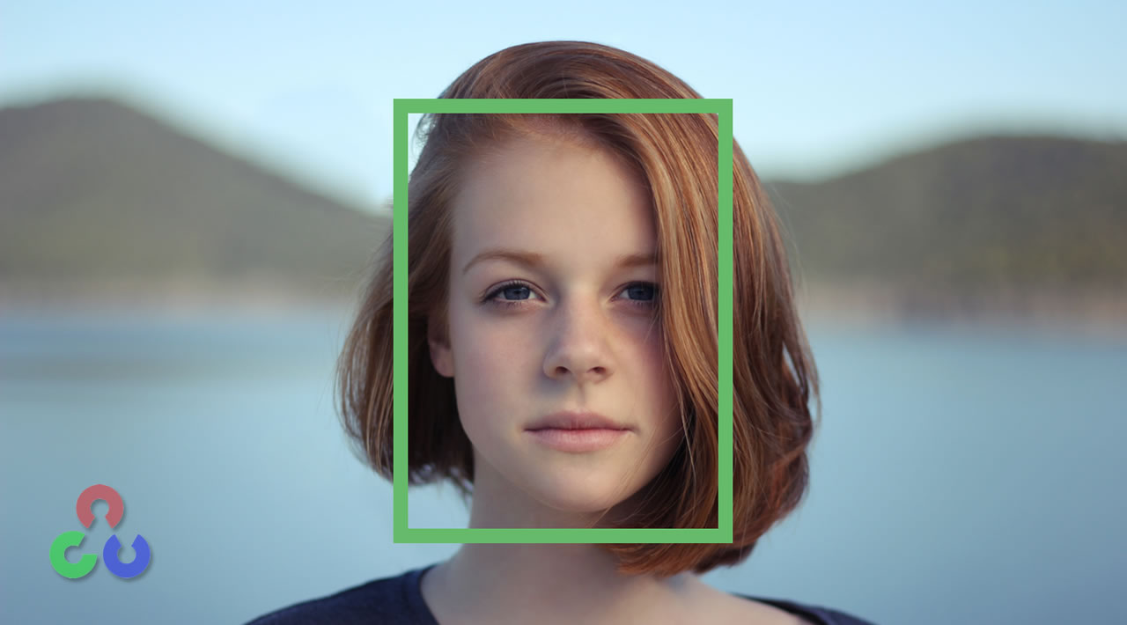
We divided the Face Recognition process into three steps:
Image Gathering- We created a dataset, where we stored for each id, a group of photos in gray with the portion that will be used for face detection.
Image Training- We took all user data from the dataset and the data was fed to the OpenCV Recognizer. This is done directly by a specific OpenCV function.
Image Recognizer- We started capturing faces on our camera and if this person had his face captured and trained before, our recognizer made a “prediction” returning its id and an index.

Slide 14
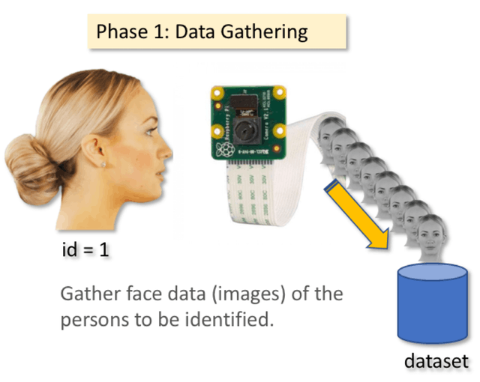

Slide 15
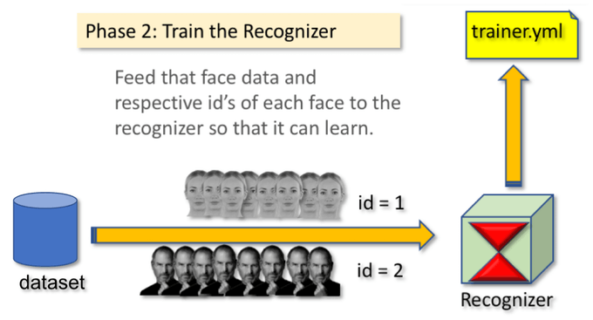

Slide 16
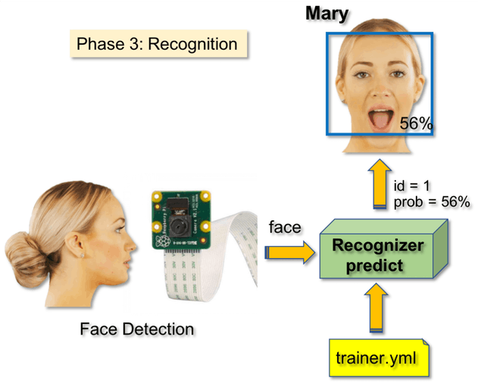

Slide 17
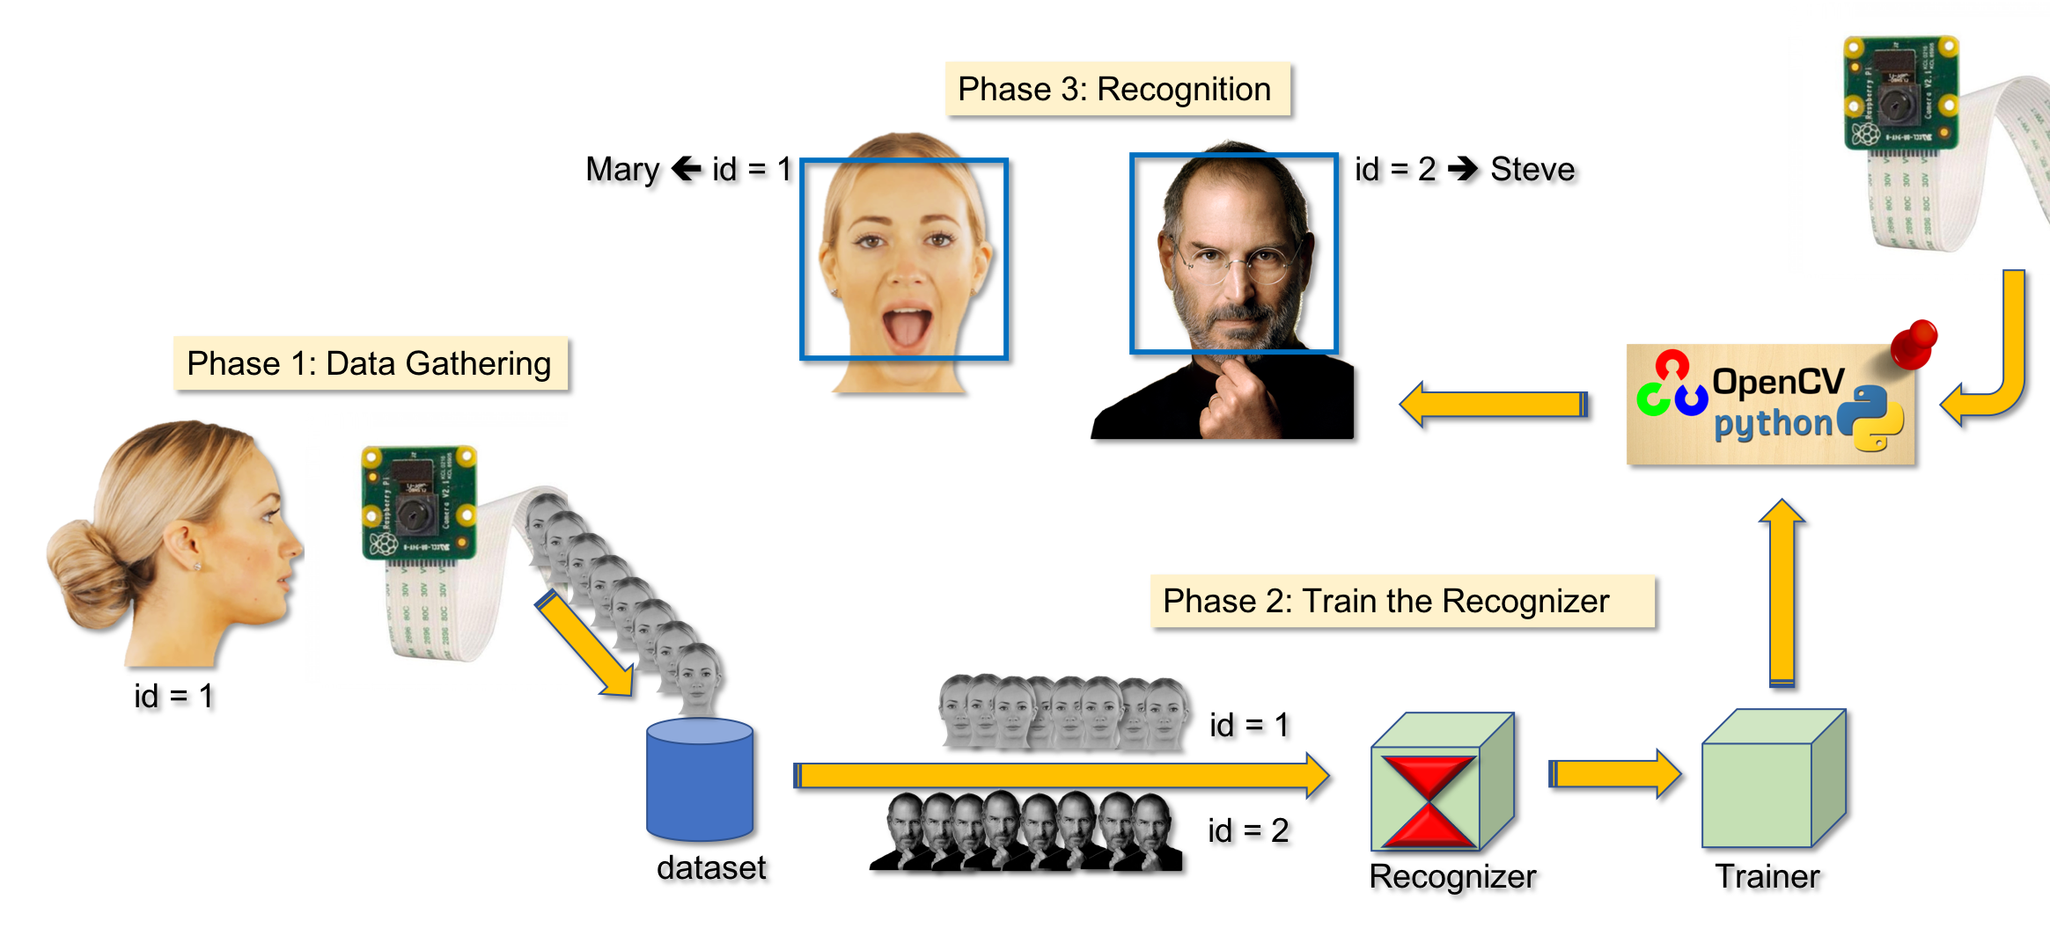

Slide 18
Imported the following modules:
cv2: This is the OpenCV module for Python used for face detection and face recognition.
os: We will use this Python module to read our training directories and file names.
numpy: This module converts Python lists to numpy arrays as OpenCV face recognizer needs them for the face recognition process.

Slide 19
ADVANTAGES
Increased Security
Easy to integrate
Making shopping more efficient
Automated Identification

Slide 20
DISADVANTAGES
Imposes on personal freedom
Violates personal rights
Technology is Imperfect
Chances of frauds

Slide 21
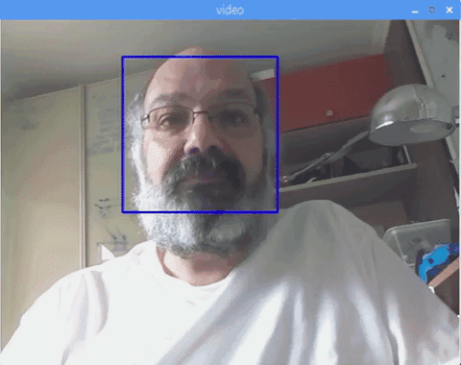
OUTPUT AFTER FACE DETECTION

Slide 22
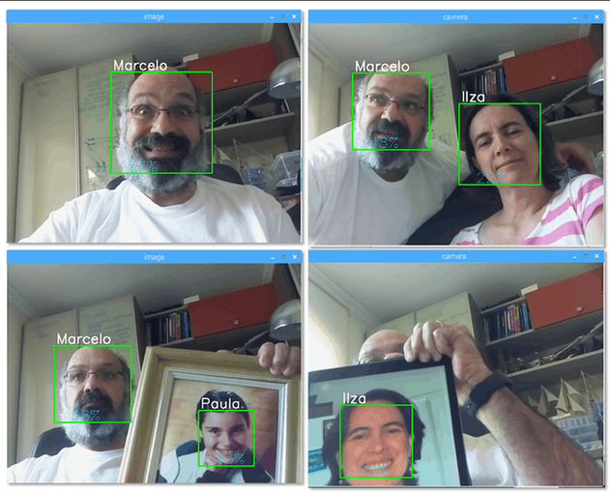
OUTPUT AFTER FACE RECOGNITION

Slide 23
THANK YOU!

